Slide 1
CARNARVON PARK PICKLEBALL SOUND STUDY
A JOINT EFFORT BETWEEN THE SAANICH PENINSULA PICKLEBALL ASSOCIATION (SPPA) AND THE VICTORIA REGIONAL PICKLEBALL ASSOCIATION (VRPA)
Notes:
Introduction:
Mr Mayor and Council, thanks you for the opportunity to present this new information to you this evening. My name is Frank Gee and I am a North Saanich Resident and taxpayer.
We realize that discussions about pickleball have been ongoing for a very long time. We would like to work with you to help find a solution that would work for the neighbours, pickleball players and you, before the court closure is imbedded in the Park Management document and OCP.
The purpose of this presentation is to report on the findings of the Carnarvon Pickleball Sound Study; to clarify some of the confusion about pickleball and to share some success stories to help inform any decisions you make going forward.

Slide 2
Basics of Sound
Human perception of sound depends on both the SOUND LEVEL and SOUND FREQUENCY content of a given sound source.
SOUND LEVEL
Sound level is generally expressed using the logarithmic decibel (dB) unit.
Because it is a logarithmic scale, a 10 dB drop is perceived by the human ear as half as loud. Sound levels over 120 dB will damage the human ear.
SOUND FREQUENCY
Sound frequency is defined as the number of times per second that pressure fluctuations occur. It reflects the 'pitch' of the sound and is expressed in Hertz (Hz).
Most municipal bylaws in BC use 55 decibels as a sound threshold.
Source: BAP Acoustics, "Noise Planning Guidelines for Outdoor Pickleball Courts, February 2023
Notes:
Let’s talk about sound.
I have a child who was born with just 25% of his hearing intact and I have been extensively involved in workplace health and safety, so I have some familiarity with sound.
Sound is measured in volume (decibels) and tone (hertz).
Very loud volume (120 dB) can permanently damage hearing instantly and permanently; repeated exposure to loud volume can cause short or long term hearing loss. Fortunately pickleball does not involve these volume levels.
We hear a wide range of tones and are more sensitive to some than others - With respect to pickleball the 'pop' sound occurs at ~ 1200 hertz
It is interesting to note that volume is generally the only measure used to define a problem.

Slide 3
Common Sounds
Sound in Decibels (dB) | Sound Source
10 | Snow fall, rustling leaves
20 | Light wind, ticking of a watch
30 | Whispering
40 | Refrigerator, quiet radio music
50 | Quiet brook, quiet conversation
60 | Normal conversation
70 | Loud conversation, passenger car
80 | Loud radio music, heavy road traffic
Notes:
Conversation fits in the range of 50-60 dB

Slide 4
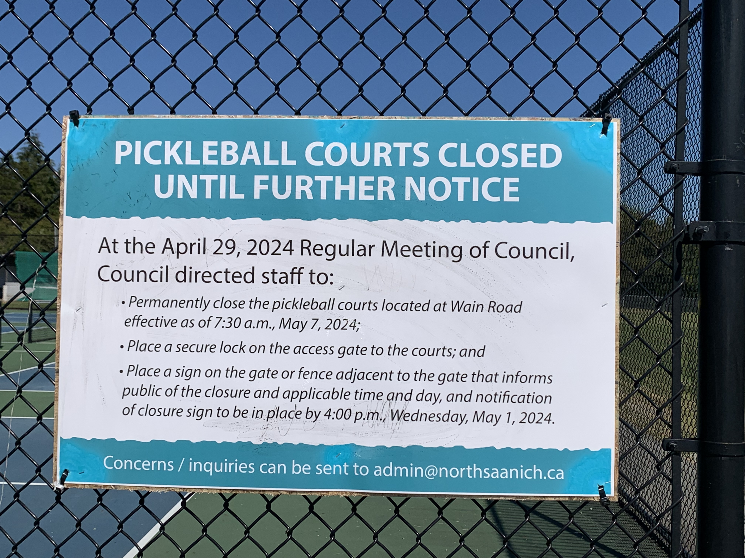
Why Conduct the Study?
To provide NEW evidence and eliminate any confusion regarding:
Decibel levels
Frequency levels (Hertz)
Effectiveness of sound mitigation panels
Effectiveness of quiet paddles
Notes:
The Carnarvon Park Pickleball Sound Study was conducted for 3 reasons:
to establish a scientific baseline
to dispel some of the inaccurate data provided through the process that led to the Wain Park court closure
to demonstrate the effectiveness of sound mitigation.
To avoid concerns of bias we engaged Jordan Mikkers of Maximum Prototyping to conduct the study. Jordan had previously done a pickleball sound study for Oak Bay and was highly recommended
Due to time constraints we will not be discussing the effectiveness of quiet paddles this evening. We would be happy to discuss the results with council at a later date.

Slide 5
Common Myths
Noise mitigation is extremely expensive
Low sound meter readings are only possible using soft balls and soft equipment
Sound mitigation panels need to be replaced often as they deteriorate in the sun
Sound mitigation is only effective in reducing decibels
levels and not hertz
Courts are being closed because sound mitigation does not work
Notes:
These are some of the inaccurate statement that were stated to be reasons for the Wain Park court closure.
We believe this presentation will dispel all of them.

Slide 6
Why Carnarvon Park for the study?
Sound mitigation was successful
Physical similarities to Wain Park
Comparable number of courts
Located on flat terrain
Surrounded by 3m (10’) high chain link fences
Bordered on one side by an open field (soft ground)
Notes:
The purpose of the study was to prove that sound mitigation using acoustic panels would work at Wain Park.
We needed to find the best available comparable park and conduct a detailed sound study. Carnarvon Park was the obvious choice
As there are many similarities to Wain Park
Carnarvon Park as five (5) pickleball courts enclosed in an unused lacrosse box. It is part of a large recreational park complex within an urban setting. Sound mitigation through the installation of acoustic panels was successful. Carnarvon Park has several important physical similarities to Wain Park;
Both are located on flat terrain –and level ground allows to break line of sight/sound to homes
Both are surrounded by 3m (10’) high chain link fences
Both are bordered on one side by an open field – soft ground attenuates sound more rapidly
The results could then be extrapolated to Wain Park to predict sound levels at nearby residences if acoustic panels were installed.

Slide 7
Keys to Successful Sound Mitigation Using Acoustic Panels
1
Panels reflect sound. Best to be installed on 3 sides to enable sound to be reflected toward the open side – allowing the sound to dissipate over a distance.
2
Must break the line of sight. If you can see it, you can hear it. In single family residential areas this requires a 3m (10') perimeter fence.
2
Must get sound levels below an acceptable threshold at nearby residences. In most municipalities in BC this is 55dB. Some municipalities, including Victoria, reduce it to 50dB to account for the "impulsive" sound of pickleball.
Must be effective in reducing the higher pitched 'pop' sound when the pickleball hits the paddle. This occurs at the frequency of around 1200HZ.
33
3
Notes:
These 3 factors were learned at Carnarvon with results easily applied to Wain Park. In a simple statement: To be effective you must
reflect the sound away from residents,
with effective sight-line elimination, and
reduce both volume (decibels) and tone (hertz).

Slide 8
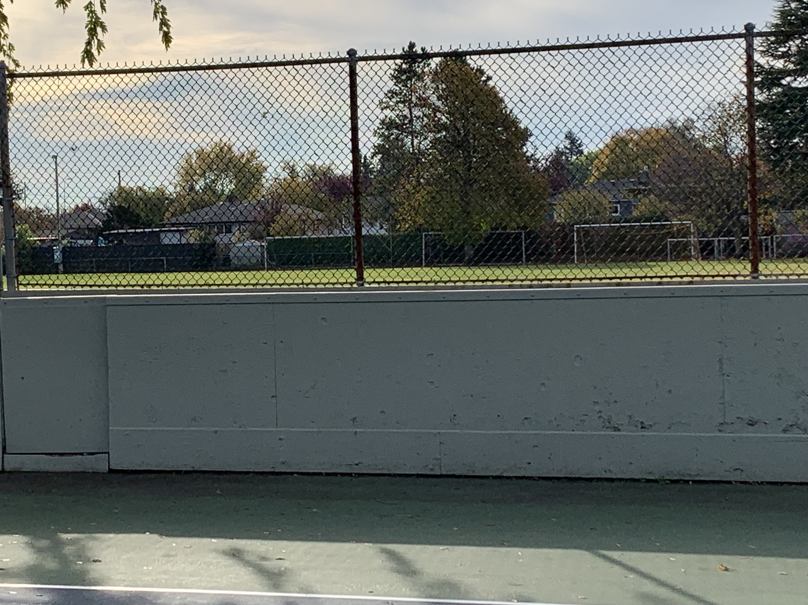
Why Did Sound Mitigation Work at Study Site?
Acoustic panels were installed on 3 sides to reflect the sound toward the open field away from nearby homes
1
Notes:
3 sides of the pickleball courts have acoustic panels, with the 4th side facing the playing field - almost identical to Wain Park
the nearest house, across the road, is 33 meters away - at Wain Park the nearest house is 50 meters away

Slide 9
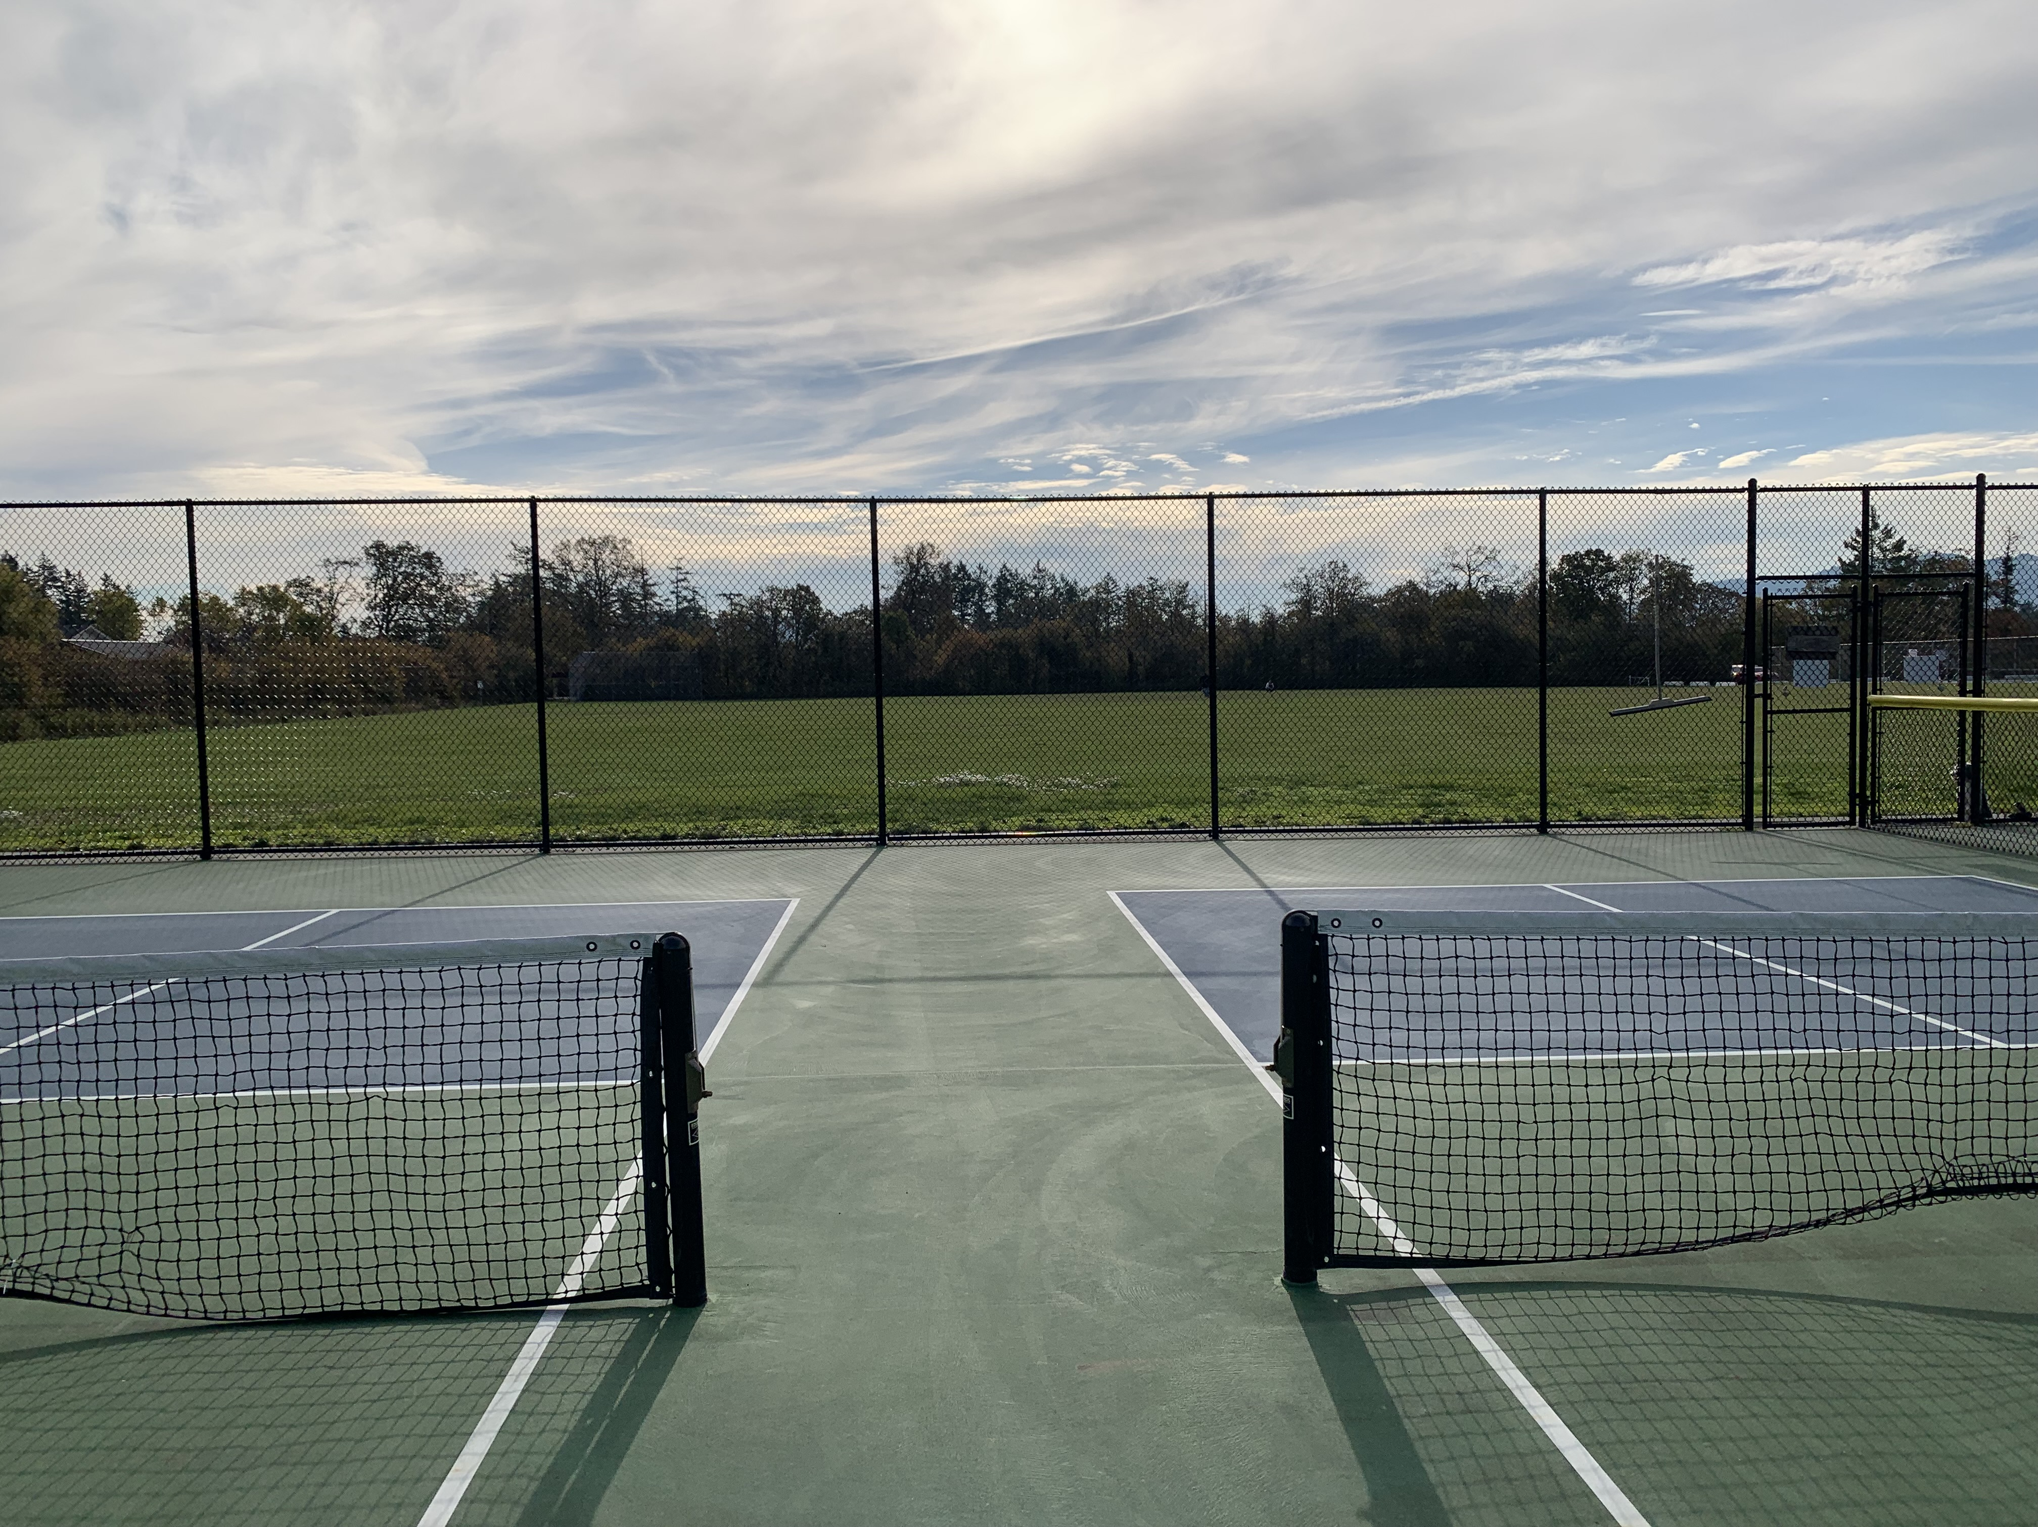
Will Sound Mitigation Work at Wain Park?
1
Yes - If acoustic panels were installed on 3 sides it would reflect sound to the open field, away from nearby homes.
Notes:
Wain and Carnarvon parks are very comparable, in terms of lay of the land, however Wain has the added benefit of soft ground and hedges and trees to help mitigate the sound.

Slide 10
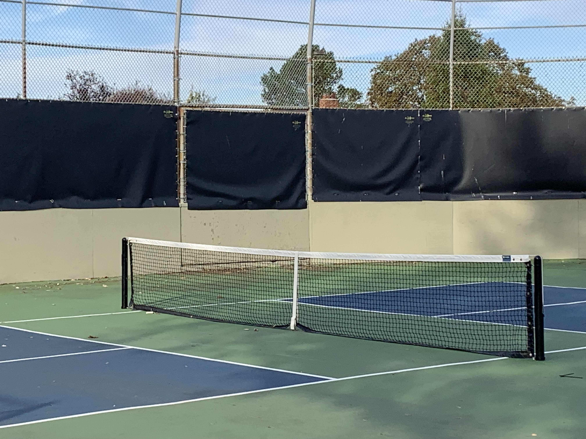
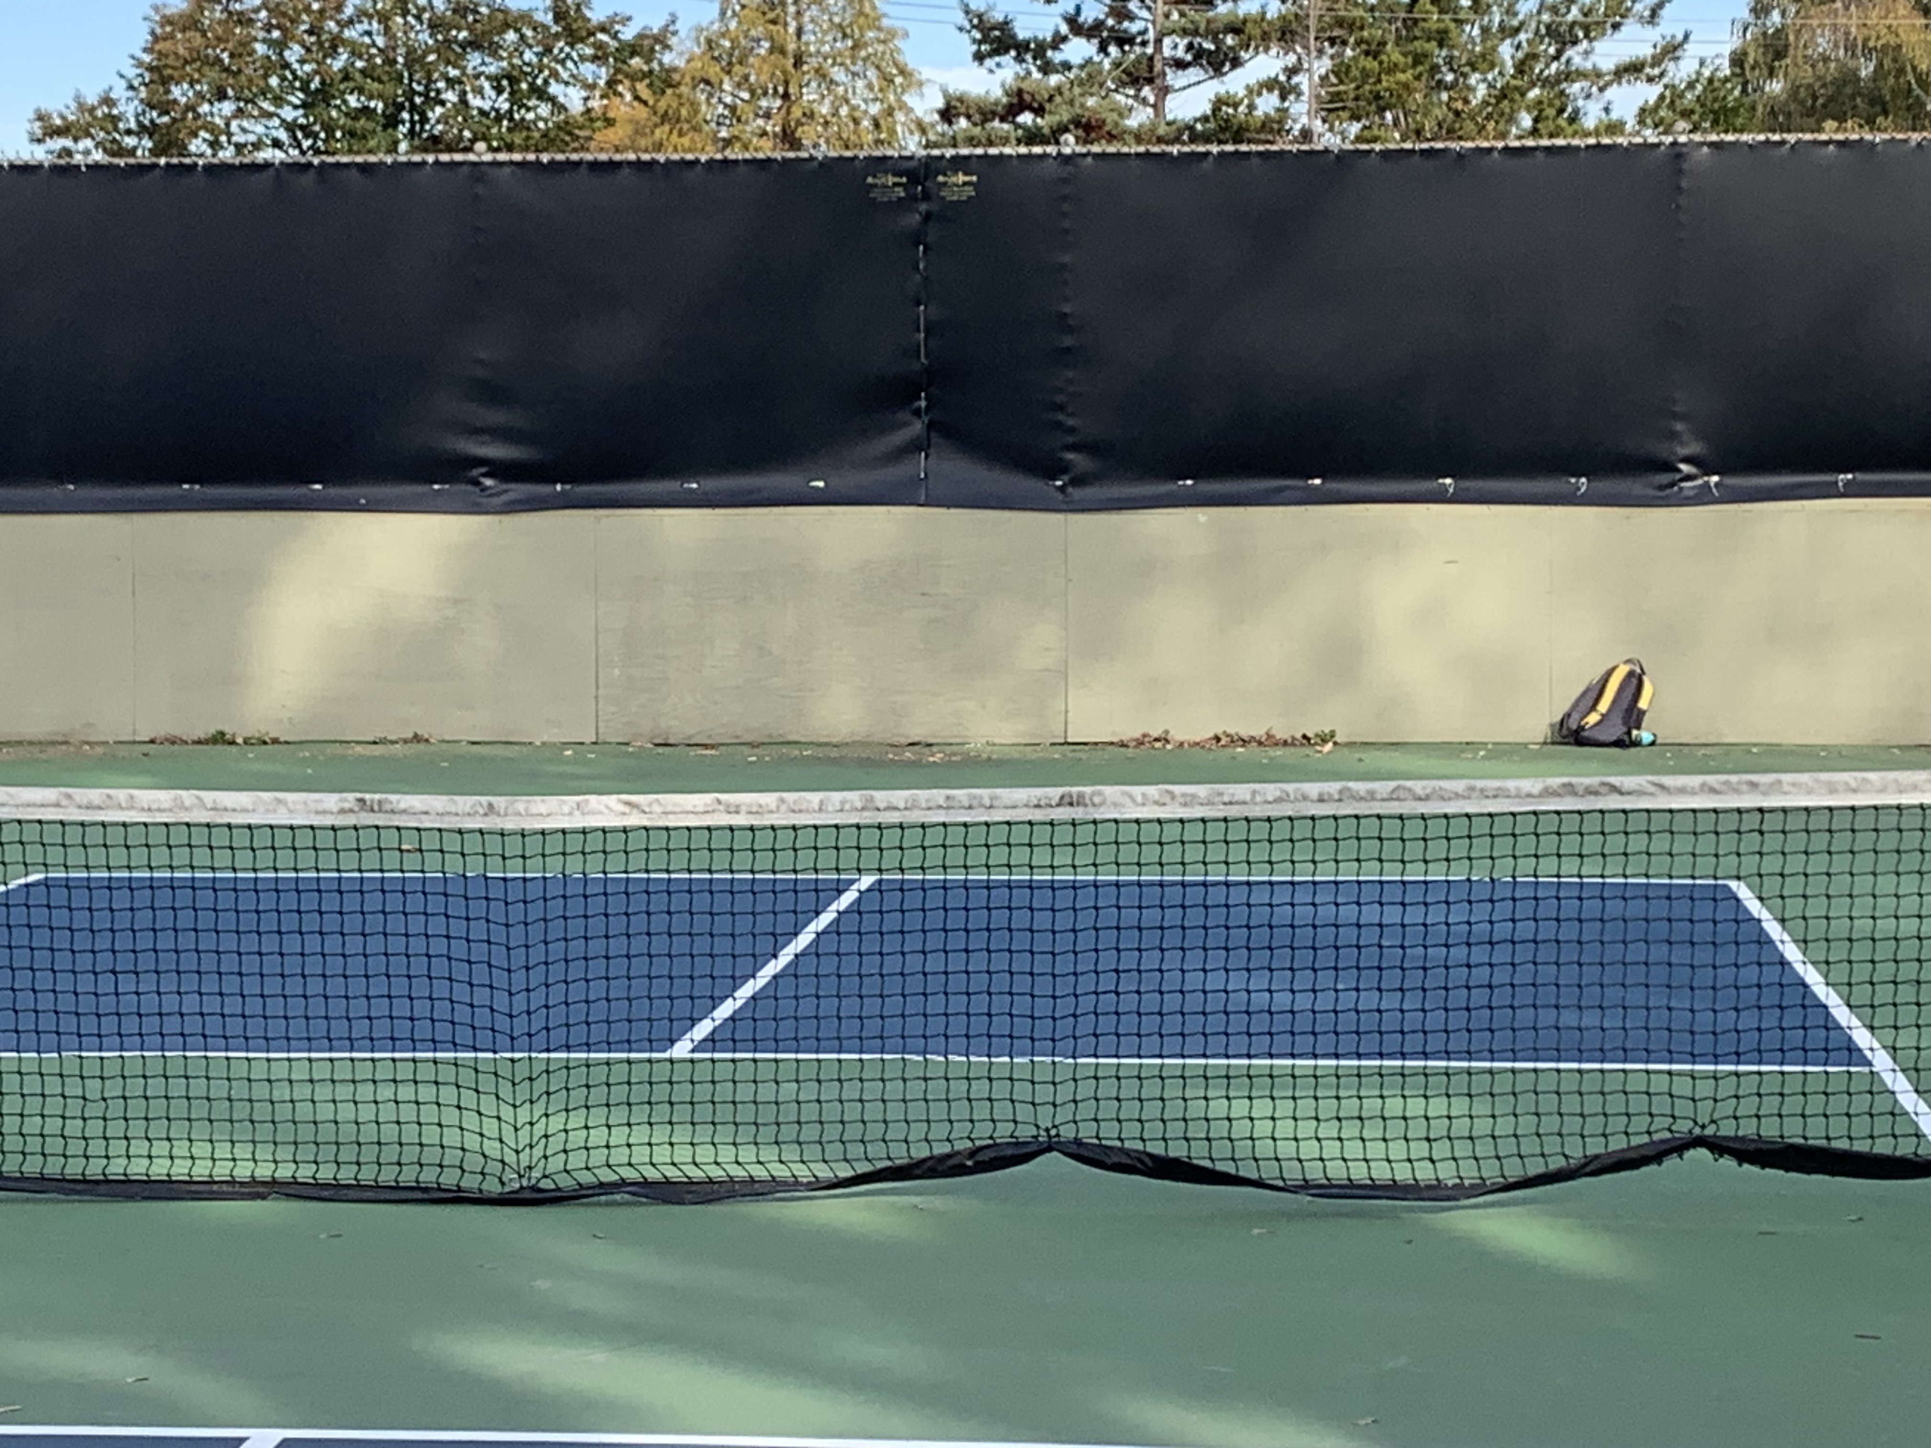
Why Did Sound Mitigation Work at the Study Site?
2
3m perimeter fence breaks line of sight/sound to nearby homes
Looking West
Looking North
Notes:
Breaking the line of sight with acoustic fencing is key to sound reduction.

Slide 11
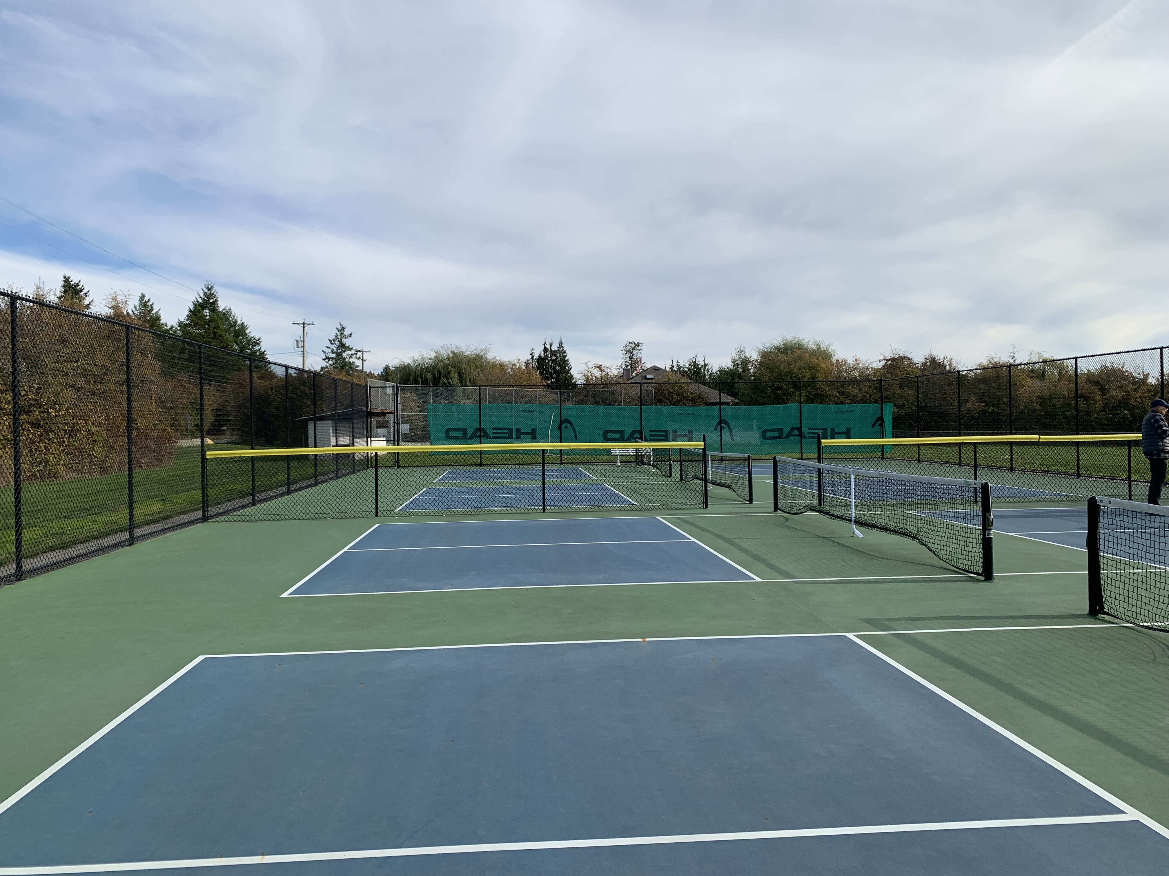
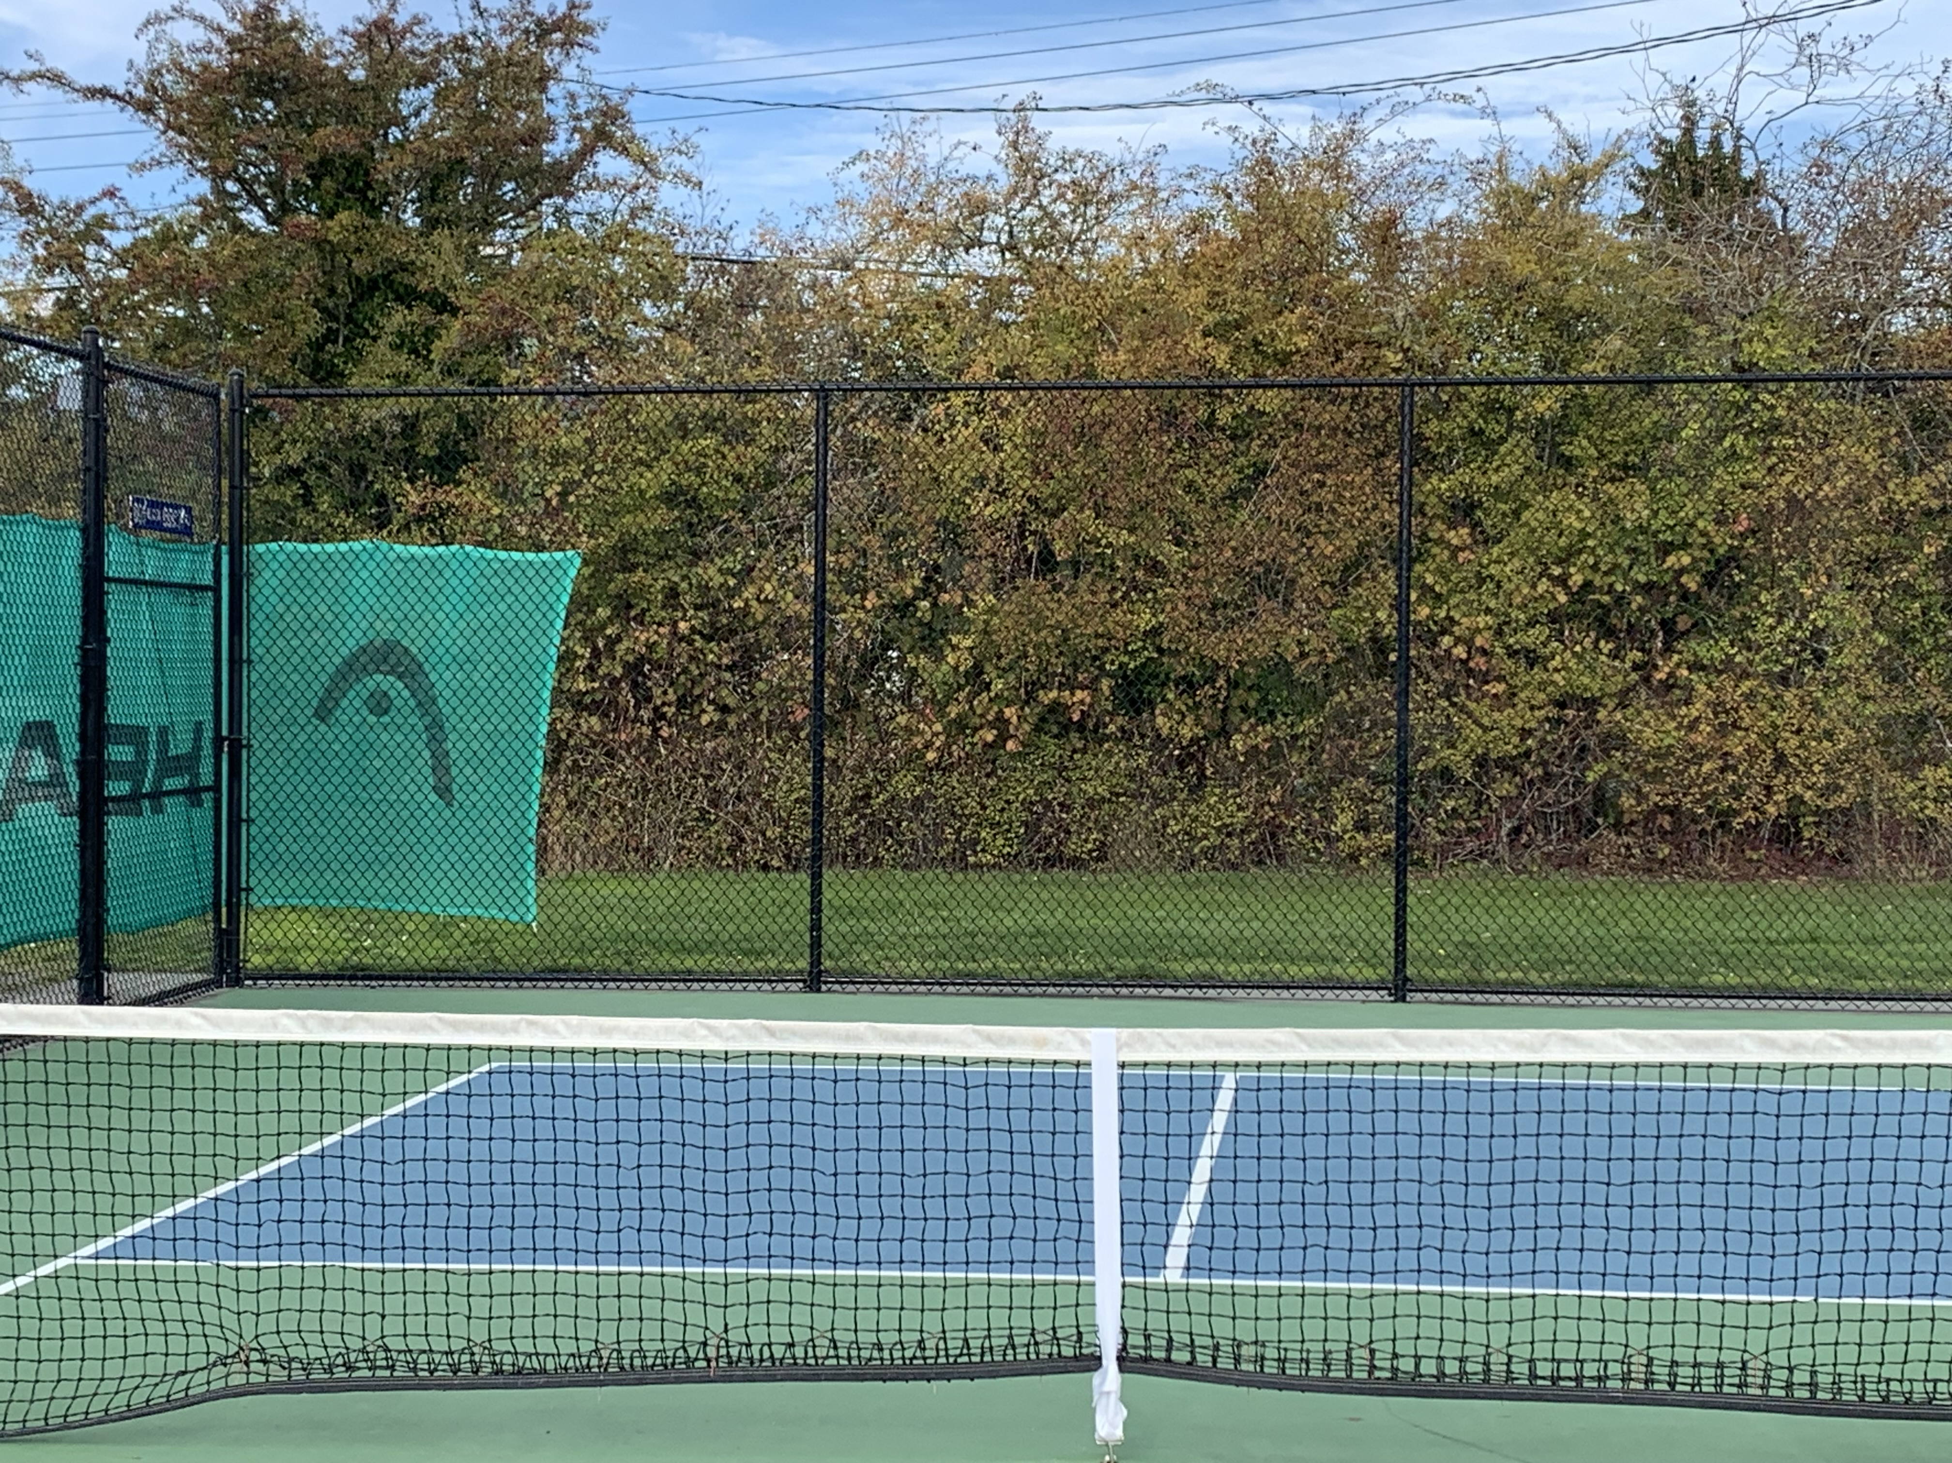
Will Sound Mitigation Work at Wain Park?
2
Yes - 3m perimeter fence breaks line of sight/sound to ALL nearby homes.
Looking East
Looking North
Notes:
Breaking the line of sight is easily achieved at Wain Park by attaching acoustic panels to the existing chain link fence. And I’ll repeat, the soft ground and hedges at Wain Park would add to acoustic reduction.

Slide 12
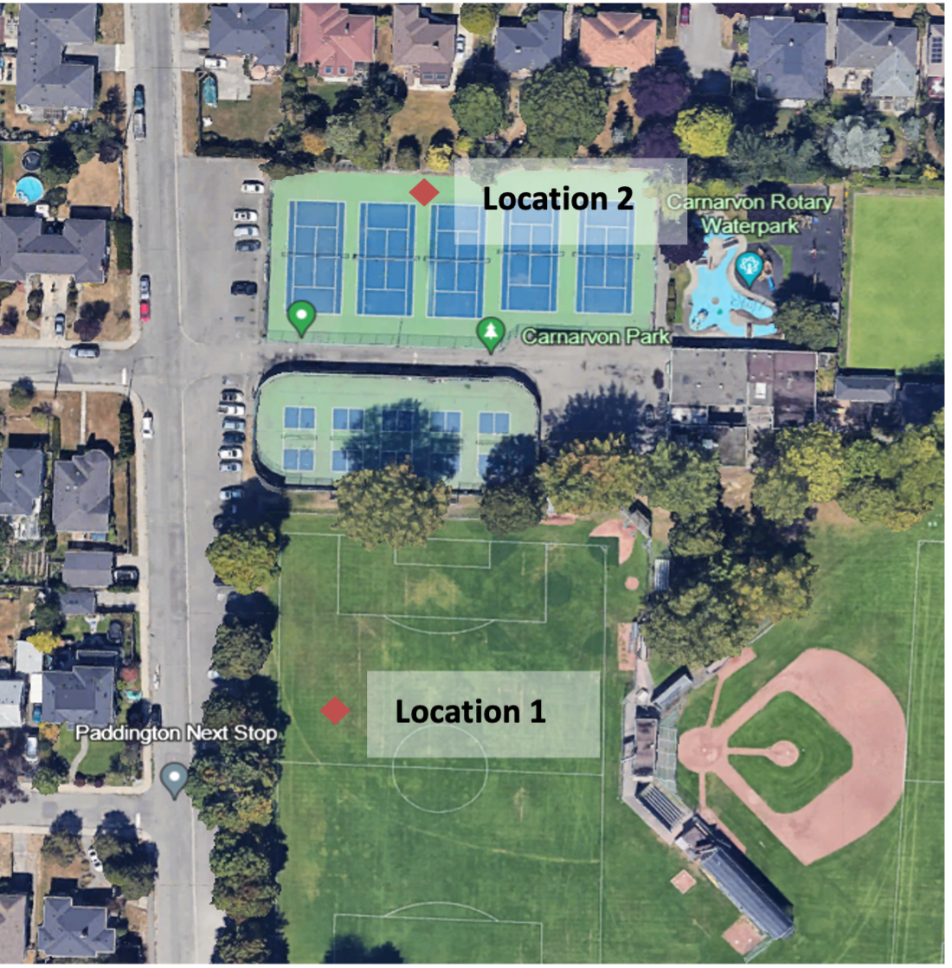
Why Did Sound Mitigation Work at the Study Site?
3
The acoustic panels brought sound levels down well below the 50dB target across the entire frequency range (Location 2)
Notes:
On the graph, the green line represents sound levels at Location 1 in the open field where sound from the courts is being reflected.
The yellow line is from Location 2 which is behind the acoustic panels. As you can see, the sound levels are well below the target across the entire frequency range .
More specifically, the decibels were lowered by 7.3 dB at the 1200 HZ range – this is the range where the 'pop' sound occurs.
Remember, for every 10 decibels decrease the perceived sound is half as loud. So a 7.3 decibel drop is very significant

Slide 13
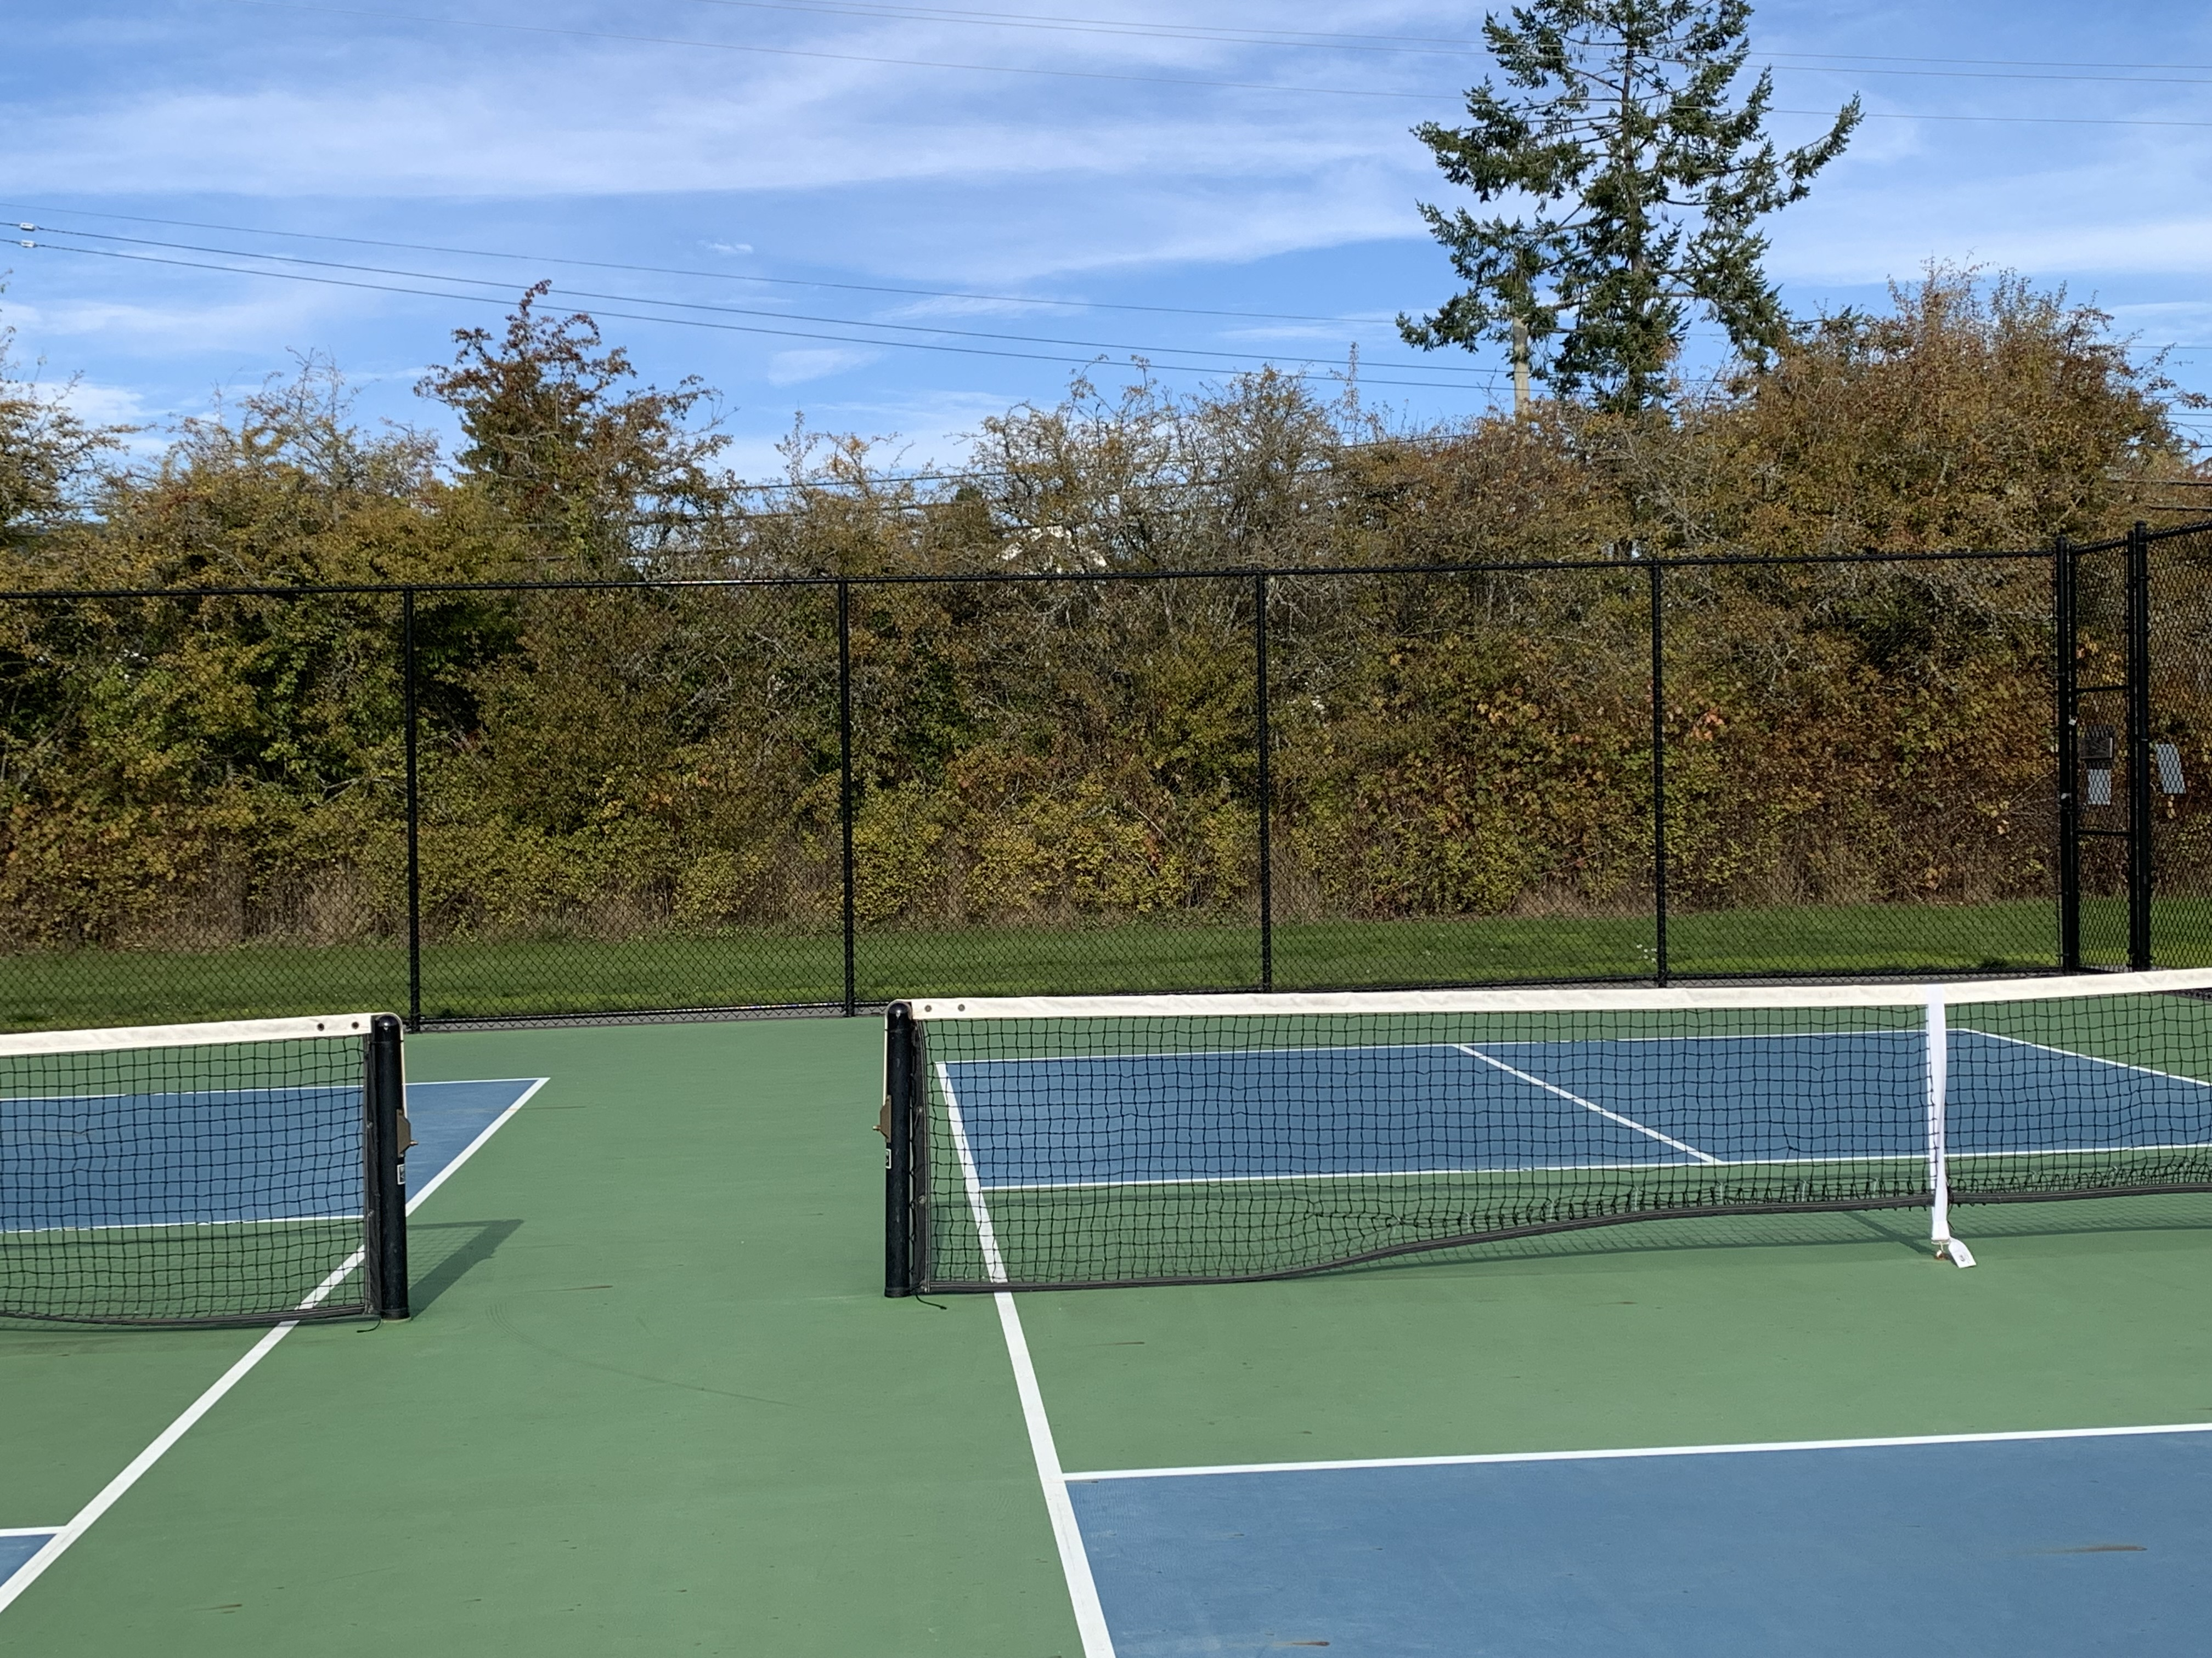
Will Sound Mitigation Work at Wain Park?
3
Yes – Data from the study suggests sound levels will be reduced by at least 7.3 decibels at 1200Hz where the 'pop' sound occurs.
Notes:
At the study site, the recorded sound levels were well below the normally accepted threshold of 50 decibels across the entire frequency range. Remember, these measurement were taken behind the acoustic panels across asphalt and hardscape tennis courts.
At Wain Park the intervening ground between the courts and the nearest homes is primarily grass and vegetation, which will attenuate the sound and reduce decibel levels even further.

Slide 14
Sound Mitigation
Durability
Effective in all
weather
conditions
Cost
$24,000 USD
or
~$35,000 CND
Notes:
Expense/Cost:
Lets shift from sound to cost.
we received a quote from Acoustifence on May 24, 2024 for $35 000 cdn
they also confirmed that only 3 sides of the courts need to be covered
we were informed that a quote received in December 2023 by NS staff, was from a local private company that would order and install panels for ~ $70,000. This quote included covering all 4 sides, and allowed for profit.
Pickleball associations can order directly from the manufacture saving NS ~$35,000
SPPA has volunteers willing to install the product under District supervision - demonstrating our desire to work together and save the District money
Also, the SPPA and VRPA offer to contribute financially to this project still stands
As for Durability……
As quoted in USA Pickleball
“Acoustifence noise curtains have been installed on public and private pickleball courts across North America, from the heat of the sunbelt to the Canadian cold. They can handle full sun 24/7/365 and up to 200-degrees Fahrenheit, and cold temperatures down to -40. Once they are up your job is done, or as we like to say, you-can-set-it-and-forget-it” (USA Pickleball, member news, August 6th, 2020).

Slide 15
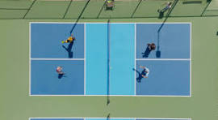
Other Success Stories
Delta Municipality
Myrtle Park , North Vancouver
Kinsmen Park, Cranbrook
Robinson Recreation Park, Penticton
Queen Elizabeth Park, Vancouver
Notes:
There are excellent examples of success stories using sound mitigation like Acoustifence right here in BC.
Delta Municipality:
Spoke with Dan Cooper, Director of parks in Delta
No courts have been shut down
Currently adding sound mitigation at Cromie park PB courts
Considering adding more courts “ we can’t keep up with the demand”, now have 19 designated pickleball courts in Delta.
Myrtle Park, North Vancouver
Spoke with Brad Snelling, Parks design and Planning for North Vancouver
Installed sound panels on 3 sides of courts
houses 50 to 60 meters away
"has made a big difference"
Kinsmen Park, Cranbrook
Talked with Trevor Thors, director of recreation
There are 8 courts situated on flat land - only 15 feet from neighbours back fence
50% of the court fencing has acoustifence panels
There is an open side that reflects the sound across an open field
Panels are good in extreme weather
No further complaints" we have neighbours calling to give us Kudos"
Robinson Recreation Park, Penticton
Spoke to Todd Whyte, parks supervisor
6 courts, houses are only 20-30 meters away
Added sound mitigation, acoustifence, to 3 sides of courts 2 years ago
"very successful"
Queen Elizabeth Park
Email received from Nicole Taddune, Landscape Architect |Senior Project Manager – Park Development, Vancouver Park Board
Hello Brad,
Thank you for reaching out to the Park Board.
Regarding our approach to noise mitigation at Queen Elizabeth Park Pickleball courts, several measures were undertaken to both mitigate Pickleball noise generated from these courts, and to understand best practices for future implementation. Our approach included:
· Installation of AcoustiFence (see attached)
· A noise evaluation conducted before and after the installation of the noise barrier
· The pre-installation acoustic study determined the recommended extents and height for the barrier and it was then installed accordingly. A post-installation evaluation indicated that the installation of the barrier had reduced the noise emanating from the courts to the extent that it is no longer discernable relative to other sources of community noise.

Slide 16
Going Forward…
We have demonstrated that…….
Sound mitigation is effective in reducing pickleball noise including at the higher frequency (Hz) levels.
Wain Park courts have all the characteristics necessary for successful sound mitigation.
There are numerous success stories of sound mitigation used at PB courts in B.C.
It is our hope that…….
Given this new information, will you consider installing sound mitigation at Wain Park as soon as possible so that the courts can be reopened
By working together we can find a solution that works for all stakeholders involved
Notes:
We want to find a solution that results in the Wain Park pickleball courts reopening. The elephant in the room is the many arguments made AGAINST keeping the Wain Park pickleball courts open. There seemed to be little focus on the actual solution: that being sound mitigation. I believe you have heard loud and clear, from hundreds of NS residents in support of the pickleball community (this includes 1794 people who have signed the petition)… that they want you to reconsider opening the courts, after the installation of sound mitigation, as discussed here.
SPPA and the pickleball community request and welcome the opportunity to participate in a stakeholder group which includes local residents, so that we can work together on a mutually acceptable solution that maintains the Wain Park pickleball courts for pickleball and respects the surrounding neighbours.
We ask you to take this request seriously.
Let the community know you will re-open, not re-purpose, the Wain Park pickleball courts. (Repurposed options in report include Handball, ball hockey, basketball–all can be very loud), who plays handball???
Establish a Wain Park stakeholder group welcoming all stakeholders: local residents, local pickleball associations, local “un-associated” pickleballers, and any other interested parties.
Work towards the installation of sound mitigation panels as soon as possible.
aside: remove all re-purposing comments in the draft Park Management Plan and draft OCP (2024) as a show of transparency and cooperation.

Slide 17
Thank You
It can work!
Delta
"No court closures. We are adding sound mitigation to 2 venues. “ Now have 19 designated PB courts.
Cranbrook
“ With sound panels installed there are no more complaints. People are calling in to give us kudos"
Queen Elizabeth Park
“After installing Acoustifence it reduced the noise emanating from the courts to the extent that it is no longer discernable relative to other sources of community noise.”
Penticton
“Sound panels were very successful"
Oak Bay
“Noise has dropped to being equal to tennis”
North Vancouver
“ sound panels made a big difference"
Notes:
Thank you and I’m happy to answer any questions you may have

